Slide 1
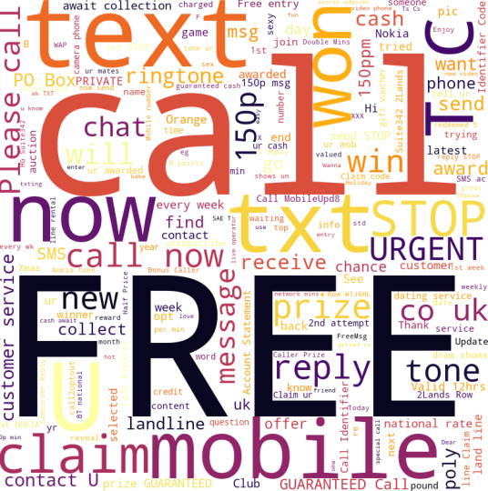
SPAM
Classifier
Team 13
Shreya Hunur
Rohit Yadav
Hashmitha Katta

Slide 2

Outline
Problem Statement
Objective
Dataset Overview
Preliminary Analysis
Project Life cycle
Model Summary
Result Comparison
Conclusion

Slide 3

Problem Statement
Because of the rapid advancement of technology used by spammers, there is a need for classifiers that are more efficient, generic, and highly adaptive. Machine learning for spam classification is a critical area of study.

Slide 4

Objective
The proposed work investigates and identifies the use of various learning algorithms for classifying spam messages from genuine text messages.
We want to train the machine learning algorithm by providing the data set so that it can learn from it and draw conclusions on its own.
This is done to identify spam messages to reduce the number of frauds occurring around the world.

Slide 5
Dataset Overview
Number of Training Samples | Number of Testing Samples | Total
4180 | 1394 | 5574

Slide 6
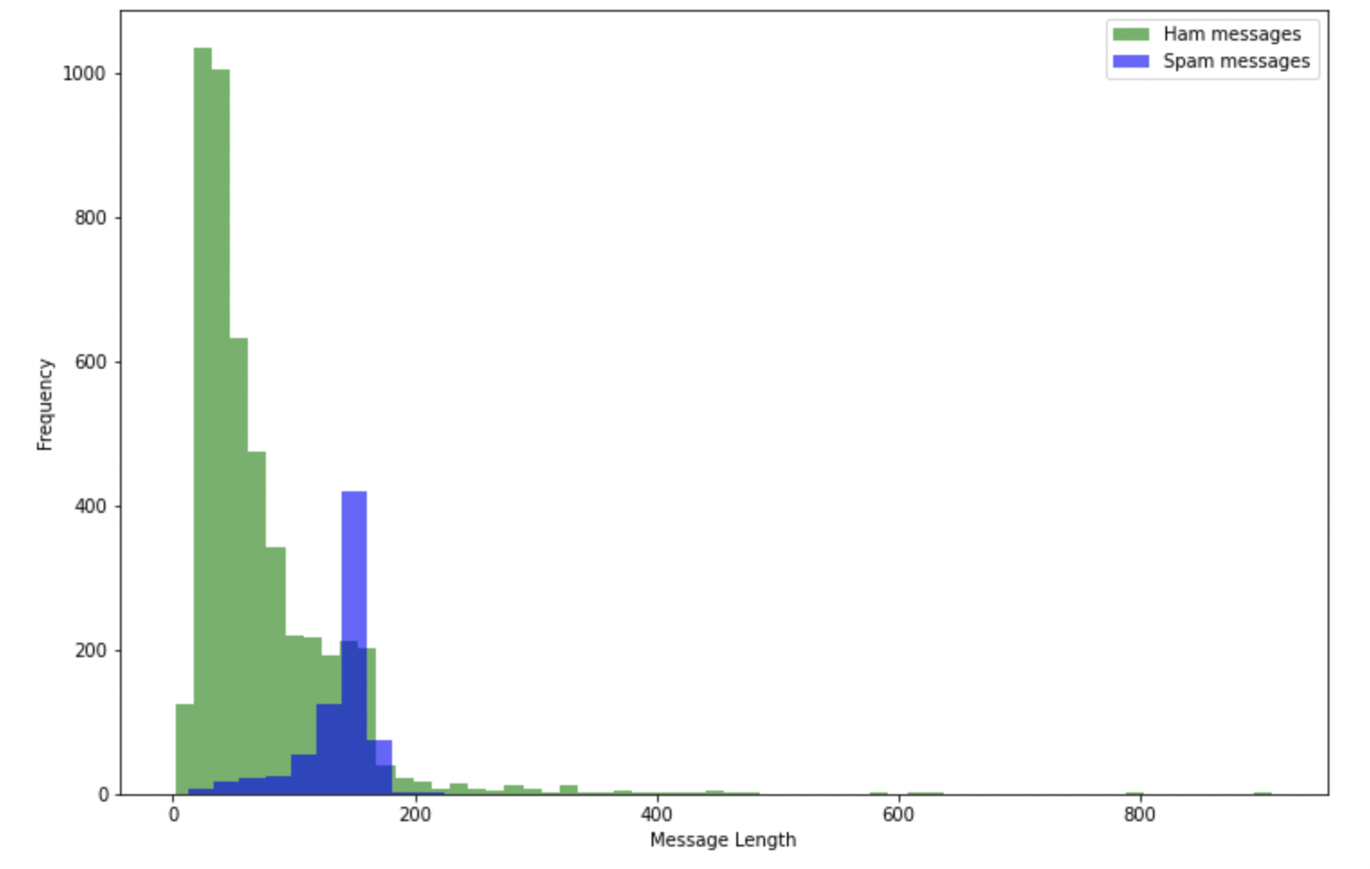
Preliminary Analysis
Feature Engineering was done and length of message was added.
Observation:
We can observe that spam messages are generally longer than ham messages: Bulk of ham has length below 100, for spam it is above 100.

Slide 7
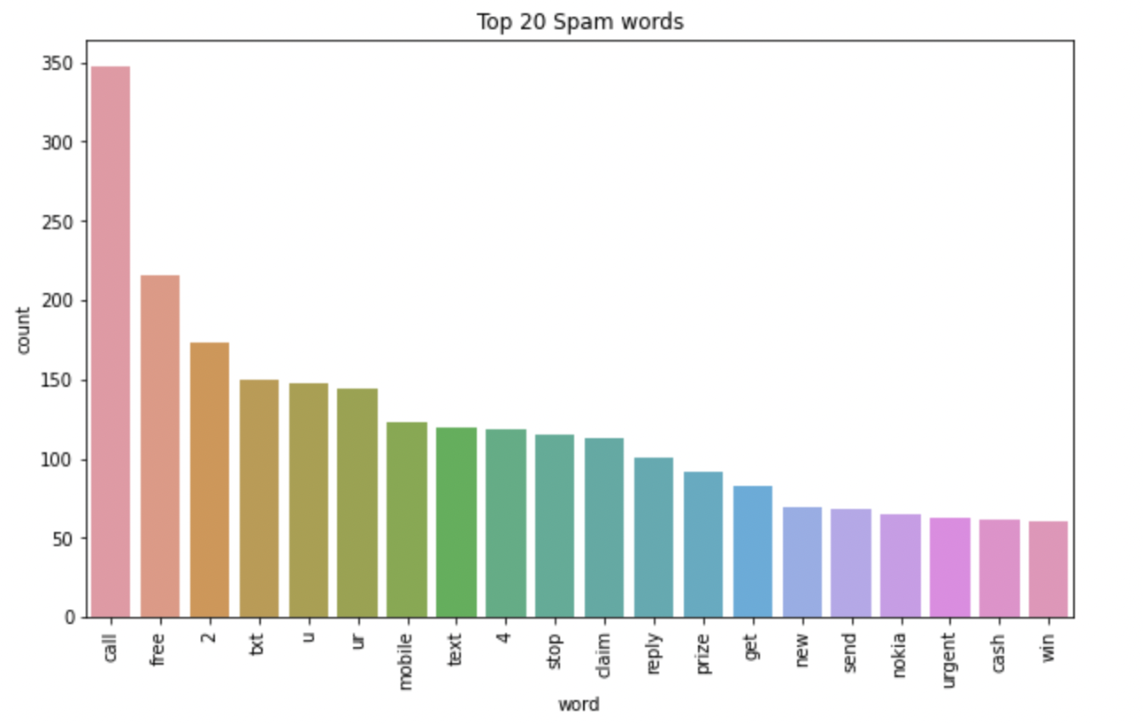
Preliminary Analysis
Most frequent spam word’s counts present in the dataset were plotted.
Observation:
We observe that words like call, free and misspelled words or abbreviations are common in spam messages.

Slide 8
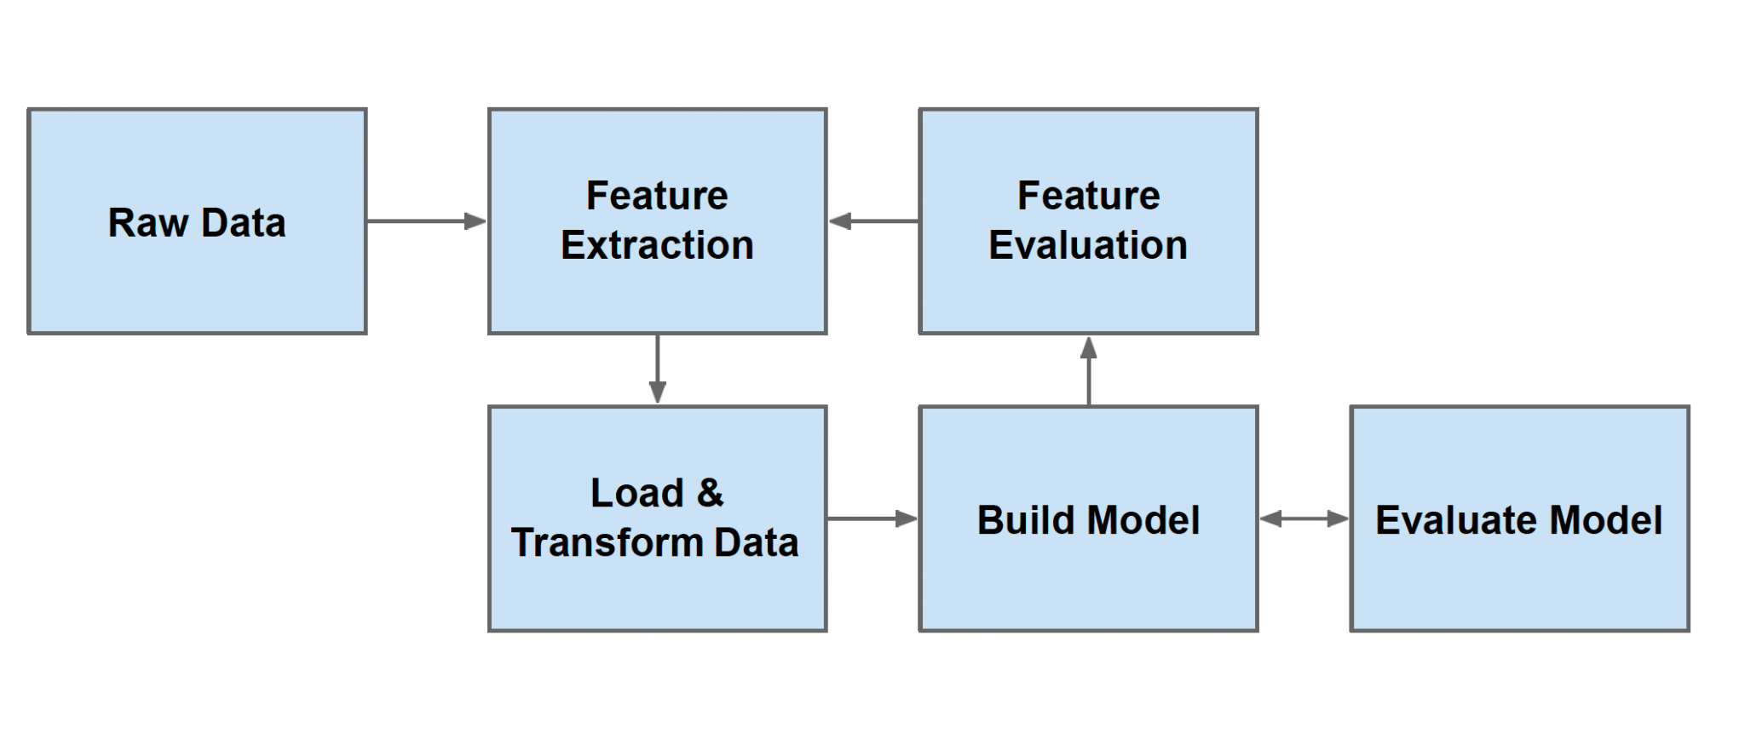
Project Life cycle
Notes:
Generally the life cycle of a machine learning project is as follows.

Slide 9
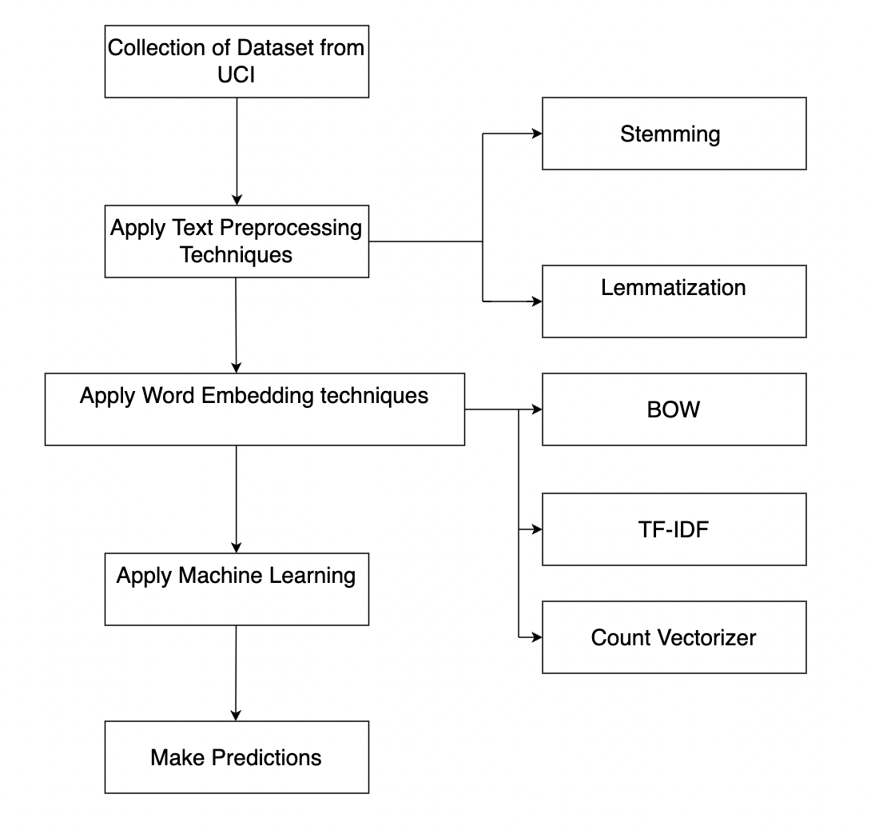
Proposed approach for SMS spam detection

Slide 10
Model Summary
KNN
Naive Bayes
Random Forest
SVC

Slide 11
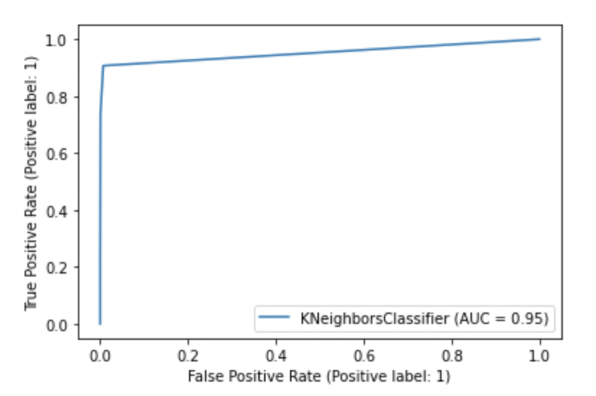
Model Summary Continued….
Accuracy | 0.89
Precision | 1.0
Recall | 0.90
F1-score | 0.94
ROC Score | 0.95
KNN
Notes:
The features of every test data item are compared with the features of every training data item in real time, and then the K nearest training data items are selected, and the most frequent class among them is given to the test data item.

Slide 12
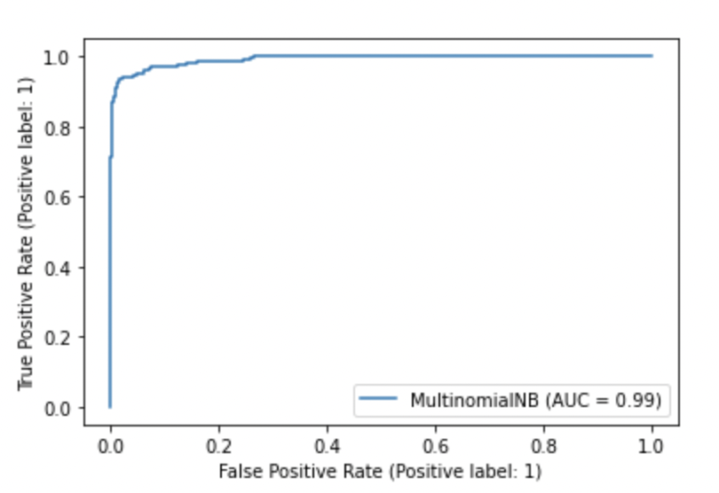
Model Summary Continued….
Multinomial Naive Bayes
Accuracy | 0.96
Precision | 1.0
Recall | 0.96
F1-score | 0.98
ROC Score | 0.99
Notes:
In our case, we have a frequency as a feature. In such a scenario, we use multinomial Naive Bayes. It ignores the non-occurrence of the features. So, if you have frequency 0 then the probability of occurrence of that feature will be 0 hence multinomial naive Bayes ignores that feature.

Slide 13
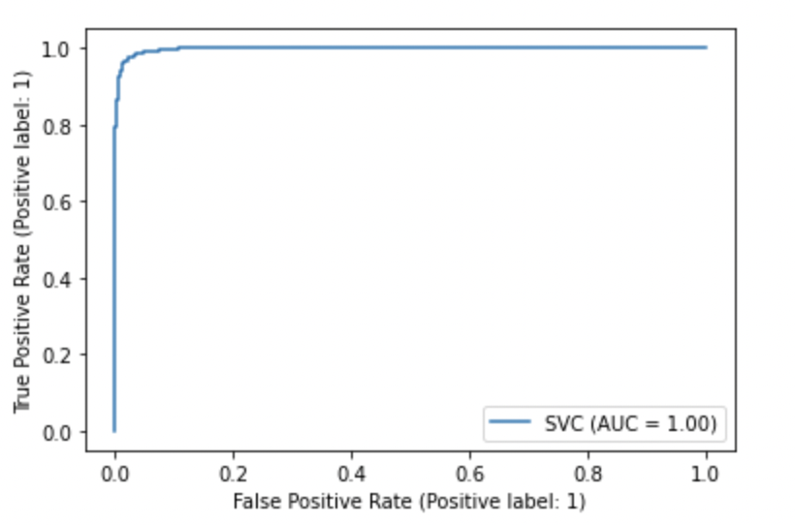
Model Summary Continued….
SVC
Accuracy | 0.97
Precision | 1.0
Recall | 0.97
F1-score | 0.98
ROC Score | 1.0
Notes:
SVM can be used a classifier. As you can see it worked quite well with our dataset.

Slide 14
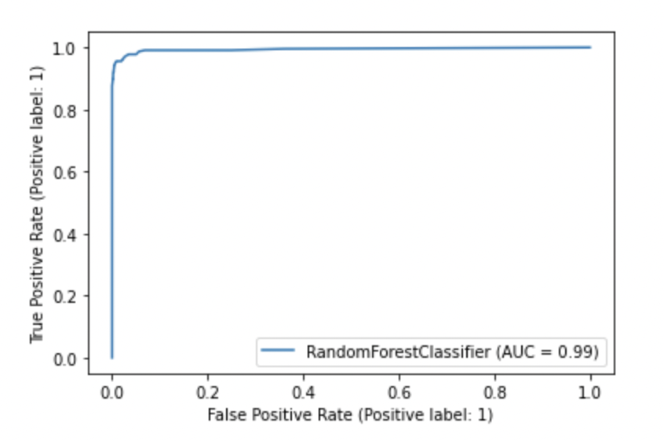
Model Summary Continued….
Random Forest
Accuracy | 0.97
Precision | 1.0
Recall | 0.97
F1-score | 0.99
ROC Score | 0.99
Notes:
RF is basically an ensemble of decision trees which makes it an extremely good classifier.

Slide 15
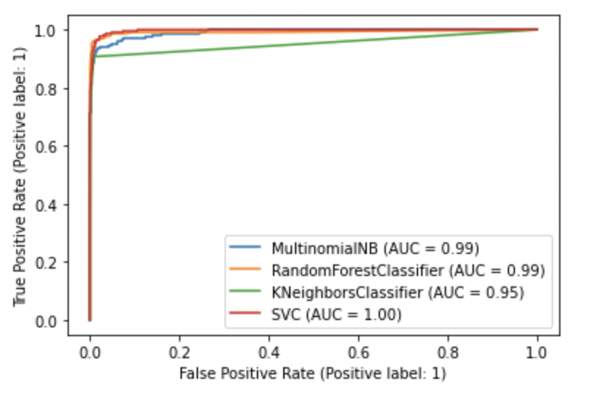
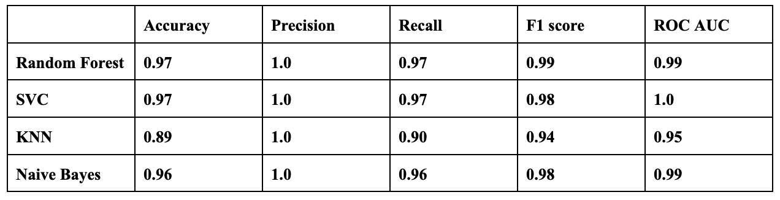
Result Comparison
Notes:
The algorithm analysis is based on factors such as accuracy, precision, recall, f1-score, and ROC. As you can see Random Forest performs exceptionally well on our dataset.

Slide 16
Conclusion
Multinomial Naive Bayes, Random Forest, SVC, and KNN are machine learning classification algorithms that can be used to distinguish between spam and ham messages using the SMS spam collection data set provided.
We used three different word embedding approaches: Bag of Words, Countvectorizer, and TF-IDF.
TF-IDF with Random Forest classification method outperforms other algorithms in the trial in terms of accuracy score. However, because the dataset is unbalanced, judging performance solely on accuracy is insufficient; precision, recall, ROC score, and f1-score of the methods must also be considered.
Following additional testing, the RF algorithm still achieves good precision, f1-score and ROC score.
Notes:
Our approach was simple. First we used stemming and lemmatization. Then since both gave almost similar results, stemming was chosen since it is faster. We have used three different word embedding approaches: Bag of Words, Countvectorizer, and TF-IDF combined with 4 models as discussed.
For each classifier, hyperparameter tuning was done to improve the performance metrics.
TF-IDF with Random Forest classification method outperforms other algorithms in the trial in terms of accuracy score. However, because the dataset is unbalanced, judging performance solely on accuracy is insufficient; precision, recall, ROC score, and f1-score of the methods must also be considered.
Following additional testing, the RF algorithm still achieves good precision, f1-score and ROC score.

Slide 17

Thank you !

